Slide 1
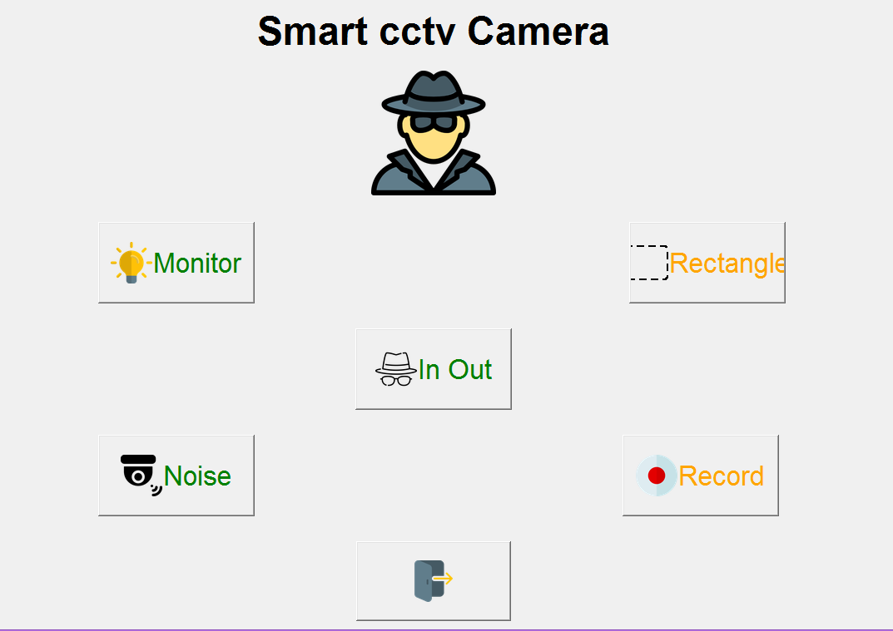
SMART CCTV
-BY
Krushnal Soni (17it111)
Savan Varotariya(17it129)

Slide 2
Overview
Introduction
Flow Chart
DFD diagram
About Project
Opencv
Modules in Project
Hardware and software requirements
Functional Requirements(Scope)
Advantages and Disadvantages

Slide 3
Introduction
The issue of mass surveillance in CCTV camera feed is very important. Surveillance can be of different forms like malicious activity detection, identification of a particular entity particular individual in a CCTV video or in general keeping tracks of movements of human beings.
In our project, the focus has been given to find the path of human through the CCTV cameras also called tracking through image processing via object detection .

Slide 4
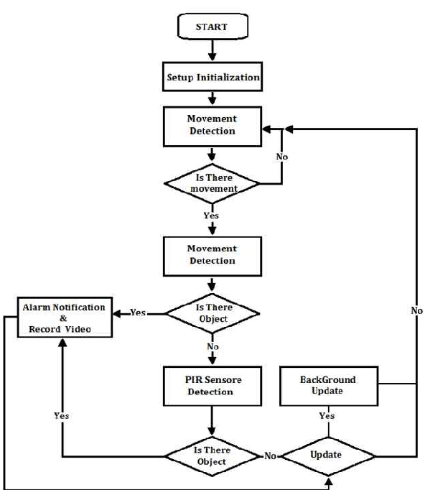
Flow Chart

Slide 5
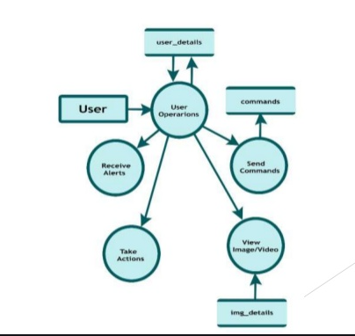
DFD Diagram

Slide 6
About Project
We have made this project in python , machine learning basically in this project we have used opencv library as we know that it is huge open source library for computer vision , machine learning and image processing.
We have used this library for monitoring the person which are present in room. Basically our aim in this project is to make cctv which record all the activity of a person like in and out time , monitoring , record the footage and many more.
Also we have used PIL (Python Imaging Library)which provides the python interpreter with image editing capabilities. The Image module provides a class with the same name which is used to represent a PIL image.

Slide 7
Opencv
OpenCV is a huge open-source library for computer vision, machine learning, and image processing. OpenCV supports a wide variety of programming languages like Python, C++, Java, etc.
It can process images and videos to identify objects, faces, or even the handwriting of a human. When it is integrated with various libraries, such as Numpy which is a highly optimized library for numerical operations, whatever operations one can do in Numpy can be combined with OpenCV.
This OpenCV tutorial will help you learn the Image-processing from Basics to Advance, like operations on Images, Videos using a huge set of Opencv-programs and projects.

Slide 8
Modules of our project
Monitor
In and Out
Rectangle
Record
Noise

Slide 9
About Modules
Monitor
A CCTV monitor is a display device that is usually connected to a feed from a surveillance video recording device.
In and Out
It generally records data of person which time he/she enters and at which time he exits in in folder and out folder.
Rectangle
In this it tells us to choose the directon or we can say we have to choose the portion , if there’s motion in that portion then it will record / track it in the form of document .

Slide 10
Record
This function in our project is been used to record the footage we have to start recording and it would save the recording when we stop so we can say it is like video recorder .
Noise
This will detect the noise of person.
Python Tkinter Frame widget is used to organize the group of widgets. It acts like a container which can be used to hold the other widgets. The rectangular areas of the screen are used to organize the widgets to the python application.

Slide 11
Hardware and software requirements
Tools and Technology:-
Image processing with Core Python
Hardware requirements :
1) x64 based processor
2) 4GB RAM
Software requirements:
1)Python 3.6 and above
2) Packages: Opencv tkinter , PIL

Slide 12
Functional Requirements(Scope)
Image processing via object detecion.
Detect -> Process -> store – it means that first it would detect the user then it will process the image after image processing is done after that it will store in form of image/video after tracking in camera .

Slide 13
Advantages and Disadvantages
Advantages :-
1) Monitors activities.
2) Collect evidence.
3) Decision Making.
4) Keep records.
Disadvantages :-
1) One of the biggest disadvantages of CCTV use deals with privacy, especially when used in the workplace.
2) Expensive , doesnot stop crime.

